Slide 1
PowerShell DSC and Service Management Automation
Plus
Using Private Feeds to manage DSC Modules
IIS Handler

Slide 2
About the Presenter
Michael Greene
ECG CAT Team
PowerShell & Automation
Architect
CAT Team
Drive Customer Feedback in to Engineering
Create Content / Accelerate Adoption

Slide 3
What We Will Cover
Main
Designing solutions using DSC and SMA together (Main)
Prototypes
Private NuGet feeds for PowerShellGet and Pull Server
IIS Handler

Slide 4
1: DSC and SMA
What we learned designing First Party Workloads for CPS

Slide 5
CPS Tenant
“Get you some of that!” 👍

Slide 6
Problem Statement
Summer 2014 – CAT team asked to build content for CPS tenant gallery
Service Providers or Enterprises acting like Service Providers will use CPS to host Applications for Tenants
WAP is the Tenant Experience for CPS
VMRoles are the method for deploying VMs + Application payload in WAP
Exchange and SharePoint did not support VMRoles for Production Deployments
VMRoles at the time: Single Tier, No Fixed Virtual Disks, etc.
Fixed disks are now an option!

Slide 7
Goal / Scope
Goal
Deliver Production Supported Microsoft 1st Party Workloads using VMRoles.
Scope
Windows Azure Pack (WAP) Multi-Tier Service based on VMRoles to deploy production-ready Active Directory, Exchange, and SharePoint, leveraging Service Management Automation (SMA) and PowerShell Desired State Configuration (DSC).

Slide 8
What did we learn
Leverage VMRoles as the delivery mechanism for DSC, orchestrated by SMA*
Leverage DSC as the lowest common denominator for Application Deployment and VM Customization
Leverage SMA to perform all the pre-requisite tasks for the VMRoles themselves (VMRole dependency, VHD Attach, Network Creation, NAT Rule Creation, Connectivity Verification, etc.)
Basically…Everything outside the VM is handled by SMA, everything inside the VM is handled by DSC (unless it is an environmental prerequisite)
Everything outside the VM is handled by SMA, everything inside the VM is handled by DSC
*SMA Runbooks are Invoked by WAP/SPF Events for Subscription.Create and MicrosoftCompute.VMRole.Create

Slide 9
Check In

Slide 10
SMA Automated Tenant Scenarios
Tenant Provisioning
Initiated by Subscription to Plan
Isolated SDN
NAT Gateways Available for Inbound and Outbound Routing
Multi-VM Service with VMRole Deployment
VMRole Pre-Requisite and Dependency Tasks
Post Deployment VMRole Tasks
Deployment Notifications
Tenant Deprovisioning
Initiated by Subscription Deletion
Removal of all Subscription Resources

Slide 11
Generic Deployment Process / Timeline*
WAP Subscription Created
VMRole Deployments Started
VMRoles Monitored
VM Network Created
VM Configuration Started
Application Deployment Started
NAT Rules Created
Fixed Disks Created/Attached
VMRole Scaled
VMRoles Completed
VMRole Deployment/Scale Completed Notifications Sent
VM Status Monitored via NAT GW Endpoint
Application Deployment Completed
Final Notifications Sent
Key
User
SMA
DSC

Slide 12
Asynchronous Deployments
Initializes Source Disk / Assigns Drive Letter
Installs Windows Roles & Features
Initializes Data Disk / Assigns Drive Letter
Runs Workload Setup
Performs Post-Install Configuration
Creates Network
Deploys/Monitors VMRoles
Creates Data Disks
Creates NAT Rules
DSC
SMA
DC-Server0001
DC-Server0002
MBX-Server0001
MBX-Server0002
CAS-Server0001
CAS-Server0002
SQL-Server0001
SQL-Server0002
SQW-Server0003
SPFE-Server0001
SPFE-Server0002
SPAP-Server0001
SPAP-Server0002
Subscription

Slide 13
Dedicated Exchange Scenario Deployment Time Comparison Small Tile vs. Medium Tile
Sync Deployment
VMRole Single Tier
2VMs
MBX = 1x 40GB Disk Copied
Async Deployment
VMRole + DSC
6VMs
MBX = 2x 250GB Disk Created

Slide 14
VMRole Scenarios
No Auto Initiation
DIY: Capacity and Availability for all VMRoles
Semi Auto
Table Stakes: Isolated Network + AD
Full Auto
Dedicated Exchange: Everything in Table Stakes + Exchange Roles (MBX and CAS)
Dedicated SQL: Everything in Table Stakes + SQL Roles
Dedicated SharePoint: Everything in Table Stakes + SQL Roles + SharePoint Roles
Dedicated 1st Party Workloads: Everything in Table Stakes + Exchange Roles + SQL Roles + SharePoint Roles

Slide 15
Workload Sizing Samples
VMRoles deployable via WAP (Driven by SMA; Configured by DSC)
Samples provided supporting virtualized Microsoft workloads
Small (single VM) and medium scalable (HA) deployments available
Suitable for different sized tenants
Scalable Collaboration Tile
Small Collaboration Tile (Dev/Test)
Exch CAS | Exch CAS | SP FE | SP FE
Exch MBX | Exch MBX | SP App | SP Search
AD | AD | SQL (Always On) | SQL (Always On)
Exch (CAS+MBX) | SP
AD | SQL

Slide 16
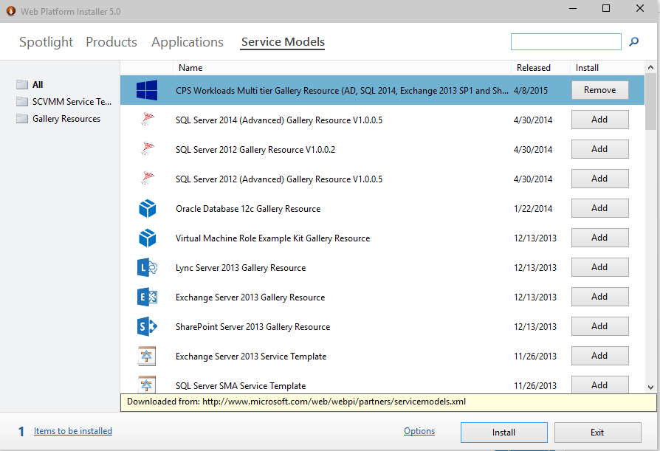
Artifacts available via WebPI
All scripts (runbooks) and DSC modules are available from the Service Automation feed in WebPI

Slide 17
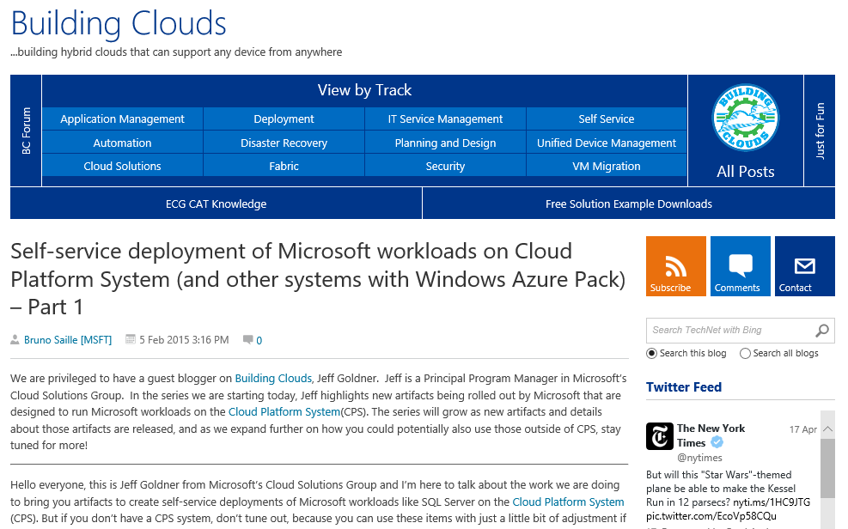
How-To on Building Clouds

Slide 18
Check In

Slide 19
2: Private Feeds
Prototypes
Using private NuGet feeds for PowerShellGet and Pull Server

Slide 20
High Level
“Private Feed” refers to a NuGet feed that is focused on serving your organization
Source for PowerShell / DSC Modules
Isolation is not a requirement
Expect that you will have multiple
The goal is Ubiquity
Demo Project Site – http://github.com/mgreenegit/git2get

Slide 21
Git2Get Demo Project
Prototype

Slide 22
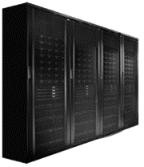
Continuous Delivery
Automated Test
Fails
Automated Test
Passes
Automatically Published in NuGet feed
Pull Server Updated by DSC Resource
Target Nodes Updated
Git Push Change to Module
Install-Module always has access to Latest
Just
Happens

Slide 23
What did we learn?
Pull Server needs a connection to this
PPM Provider and DSC Module
DSC Modules focused on scenario:
xCertificate
Update to xDSCWebService
Update to xWebSite
Check for repo’s https://github.com/mgreenegit
I will check in the above work this evening during the hackathon time

Slide 24
3: IIS Handler
Prototypes
Prototype

Slide 25
Experiment
Question
What if you could author webpages in PowerShell?
Not attempting to solve a specific problem. Purely a “what if” exercise.
Issue
No web platforms today have ability to process PowerShell and render output
Prototype
IIS Handler

Slide 26
IIS Handler
Prototype

Slide 27
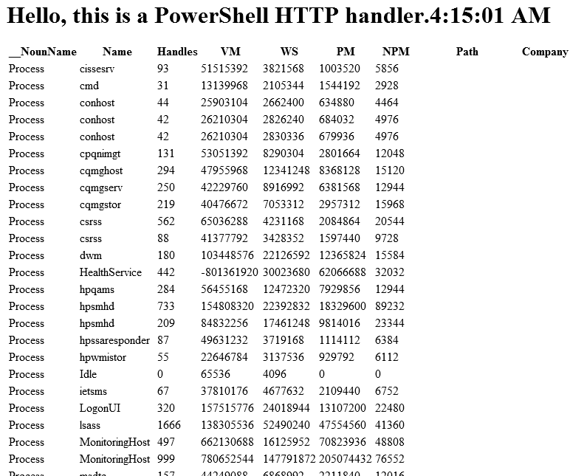

Simple Website

Slide 28
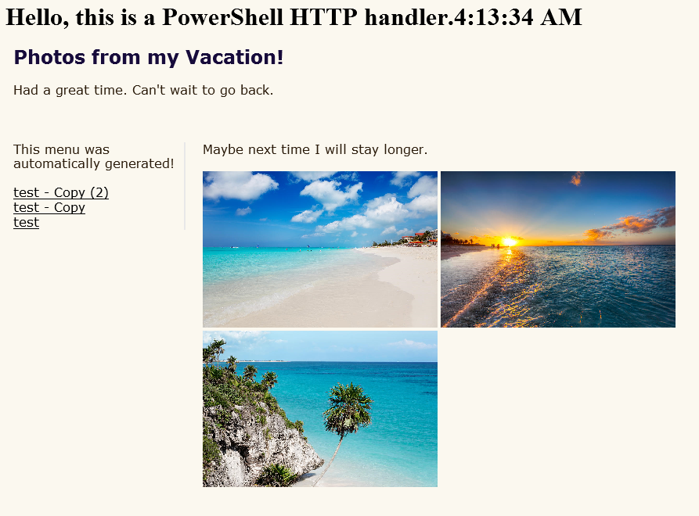
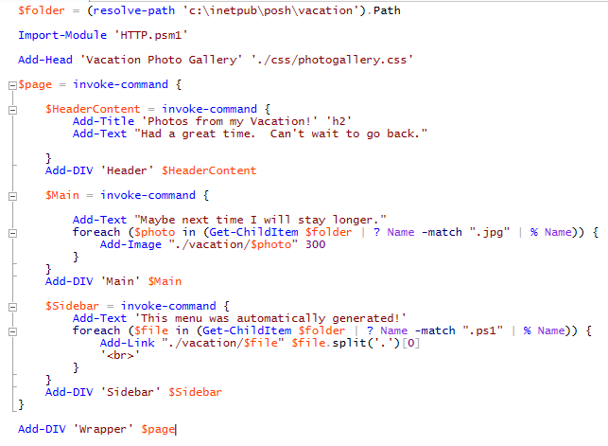
Photo Gallery Website

Slide 29
What did we learn?
Technology
Very easy to prototype, high potential for solution
Value is in Modules
Feedback
IT Pro/Dev with PowerShell knowledge: “Great!”
Developer: “Why?”
What’s Next
Open Source the Project

Slide 30
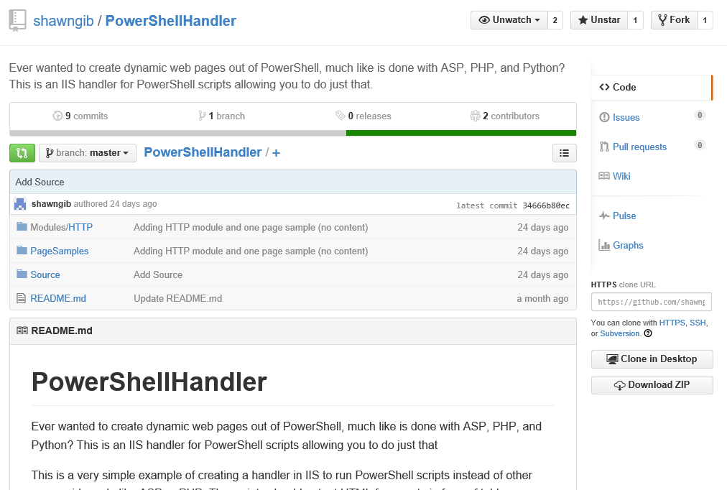
Open project
Published under Shawn Gib’s account on GitHub
https://github.com/shawngib/PowerShellHandler

Slide 31
How to Contact Me
Website: http://aka.ms/bcb
E-Mail: Michael.greene@Microsoft.com
Twitter: @migreene
LinkedIn: Sure

Slide 32

Thank You
Please fill out an online session evaluation – they are an important part of making the Summit great!
Recorded sessions are posted on the PowerShell.org YouTube channel. Visit PowerShell.org for more information.

